Slide 1



G H Patel College of Engineering & Technology (A Constituent College of CVM University)
Subject Code: 102000801
Internship At
Project Title : HalloDoc – Consultation and Diagnostic Platform
Name : Karmadipsinh Solanki
Enrollment No. : 12002040501025
Internship Guide : Sweety Patel
College Guide : Prof. Khyati Mehta

Slide 2
Table of Content
Company Profile
Internship Planning
Assigned Project
Technology Used
Outline of Work Done
Conclusion of Work Done

Slide 3

Company Profile
TatvaSoft is a Microsoft solutions partner software development company which delivers splendid business IT solutions to the customer across the globe.
We are a Consummate Custom Software Development company delivering splendid business IT Solutions and related services to customers across the globe. Our development services are led by our dedicated and passionate team to provide best industry practices combined with technology expertise and business domain knowledge to drive digital transformation.
We have successfully served for more than 1800 success stories ranging from Enterprise level to Start-ups, who have grown alongside the success of the company.

Slide 4
Our Services:
Custom Software Development
Web Development
Dedicated Development Team
Software Product Development
Ecommerce Development
Mobile App Development
Software Testing & QA
UI/UX Design

Slide 5
Internship Planning
Beginning with front-end development
of
Patient site
Implementing backend with ASP.NET MVC Core and integrating it with front end of Patient Site
Finally, Developing physician website along with database integration
Along with the
development of front-end of patient site we will parallelly learn ASP.NET MVC Core
Learning HTML,CSS,JS,
Bootstrap and
Github
Developing admin website along with database integration

Slide 6
Assigned Project
Project Name :- “HalloDoc Platform”
The platform will offer online Doctors consultation and Diagnostics services:-
->serves as a valuable tool for doctors to enhance patient care,
->streamline their work processes.,
->simplifies various tasks for doctors,
->patients can utilize the website to request care for themselves.
Technology : .dotnet

Slide 7
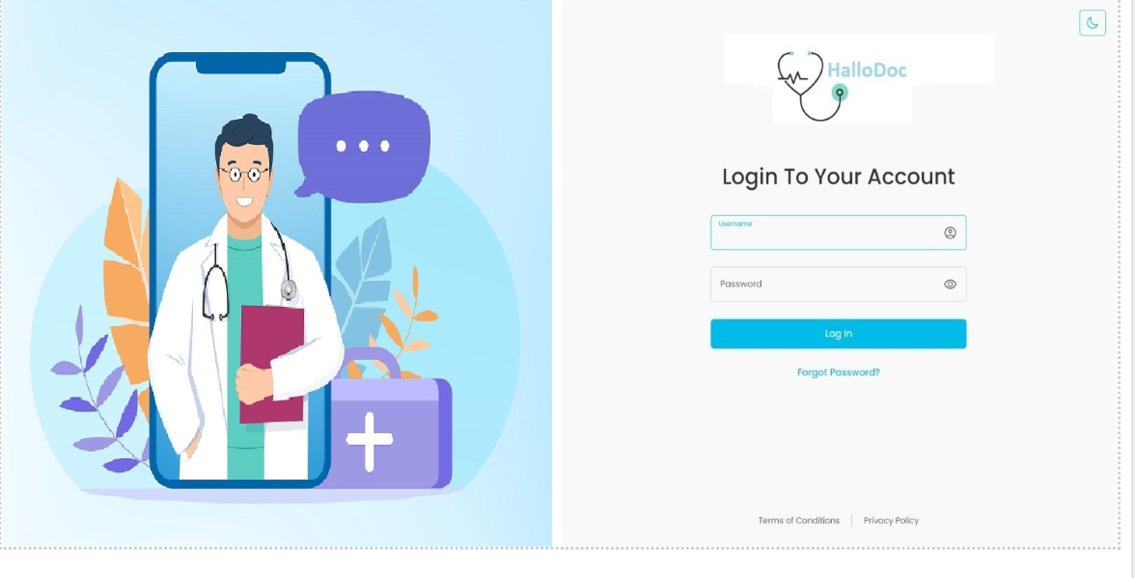
UI : Platform Login page

Slide 8
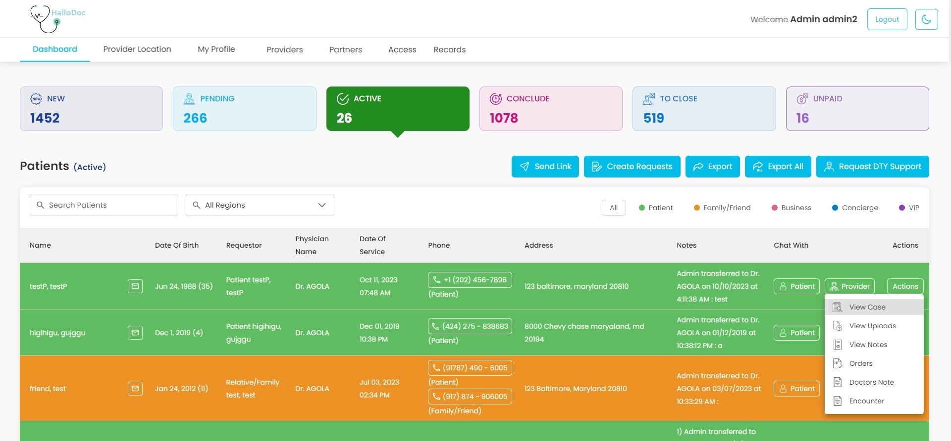
Admin Dashboard

Slide 9
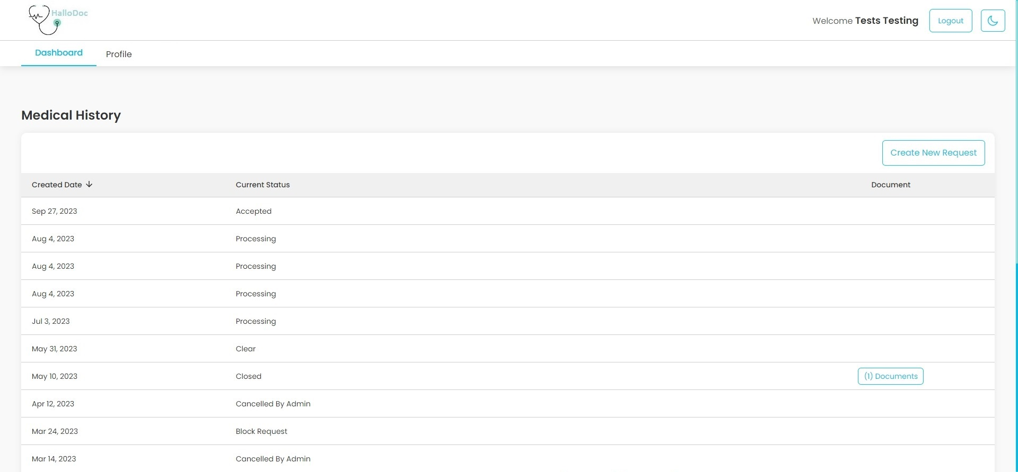
Patient Dashboard

Slide 10
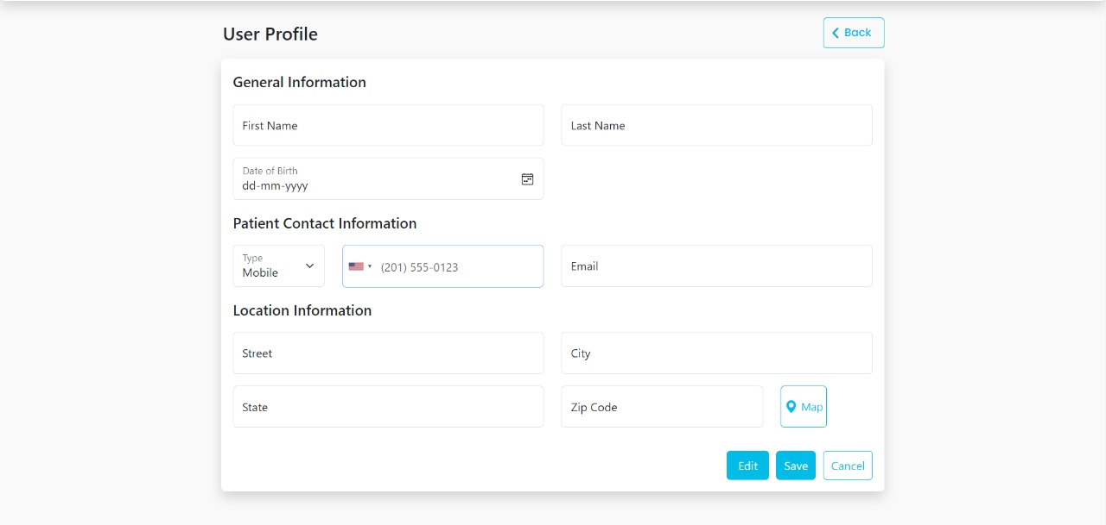
Patient Profile Page

Slide 11
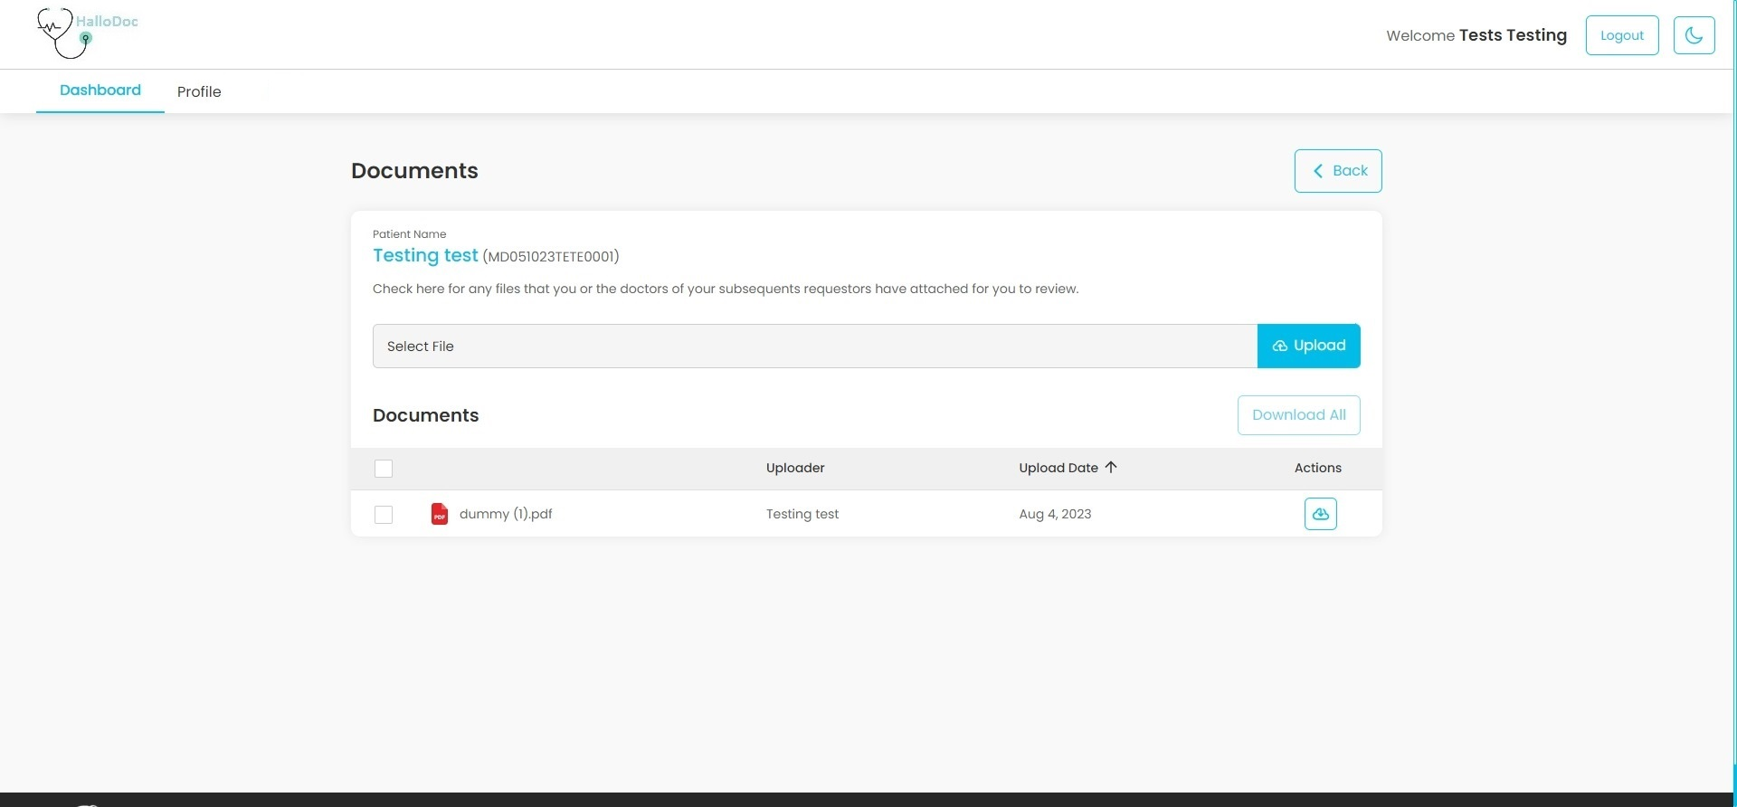
View Document Page

Slide 12
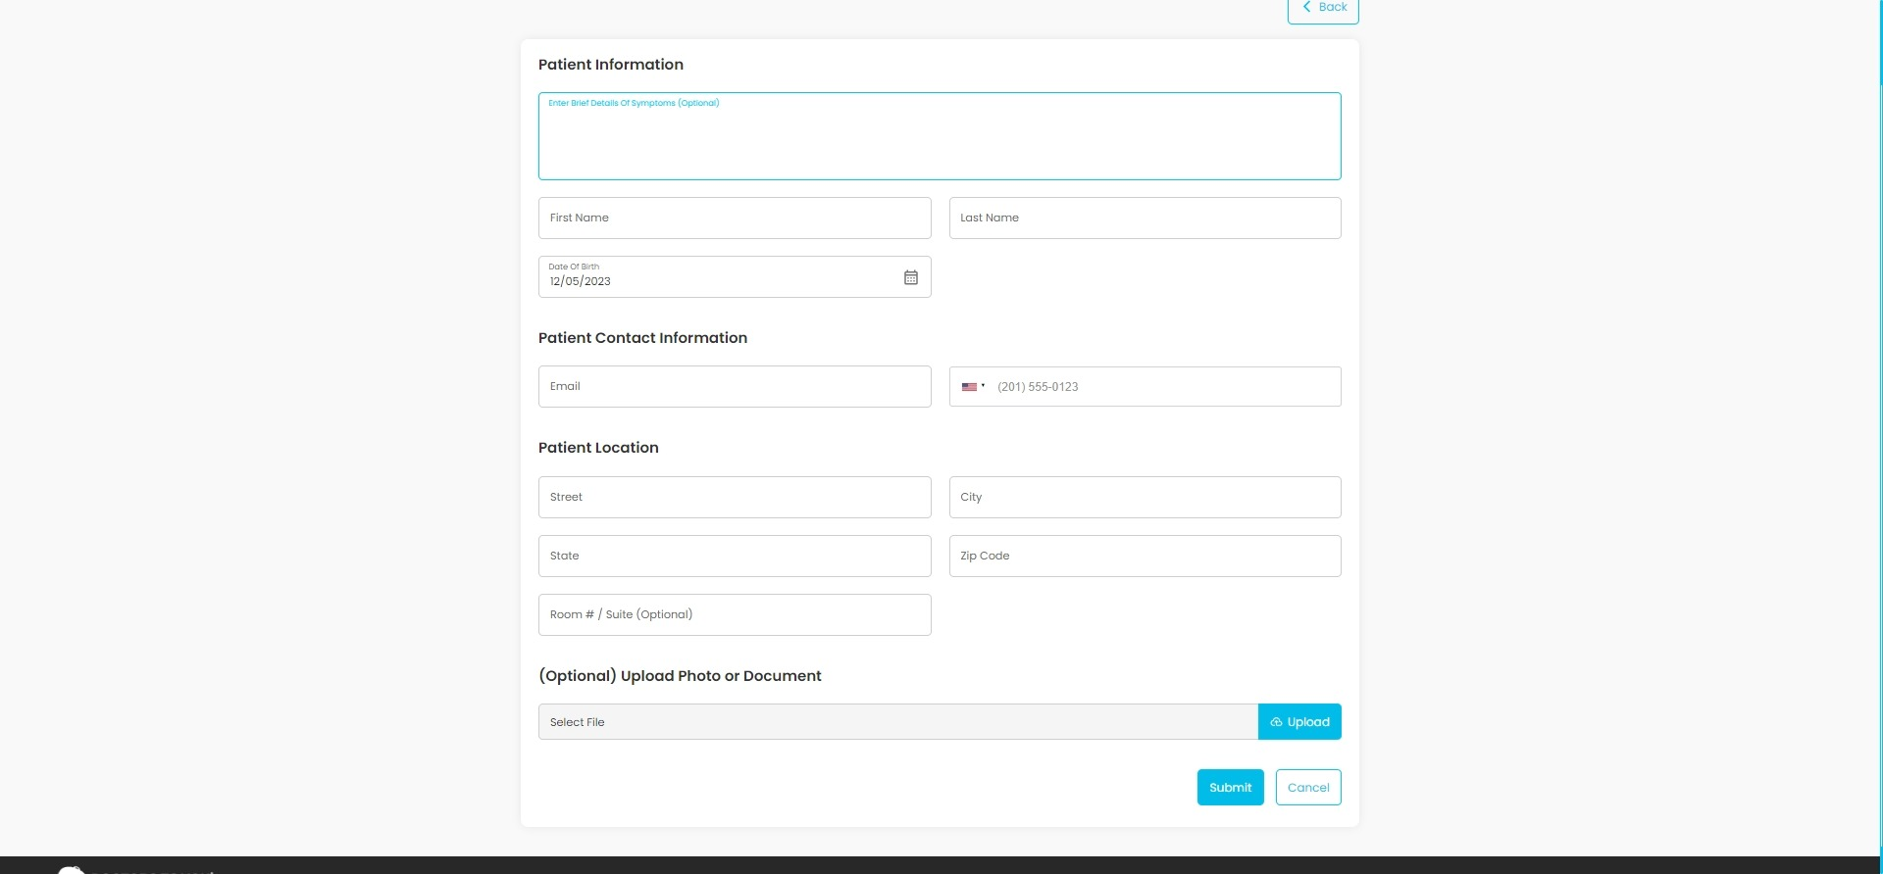
Create Patient Request Page

Slide 13
Technology Used
Front-end: HTML, CSS, JavaScript and Bootstrap.
Back-end: ASP .NET Core MVC, ASP .NET Core API
Database: PostgreSQL
Tools/IDE: Visual Studio 2019, Visual Studio Code 2022
Source Control Repository: Github

Slide 14
Outline of Work Done
Assignments based on learning of front-end development concepts.
Basic and advanced concepts of HTML, CSS, JS and Bootstrap.
Creating and Integrating UI pages of Patient Side of project HalloDoc.
Converting whole project from 1-tier to n-tier
Creating and integrating Admin Dashboard and other few pages of Admin Side.

Slide 15
Conclusion
Till now, We learnt frontend creation using html, css, js and database creation and integration and advanced concepts of ASP .NET Core MVC 7. The learning and implementing of concepts helped us to build our internship project.
Along with that, working with professionals enhanced our communication skills, teamwork and problem-solving abilities.

Slide 16
References
Company website: https://www.tatvasoft.com/
Project SRS

Slide 17
Thank You

